Slide 1

8086 Assembly
Problem Set 2

Slide 2
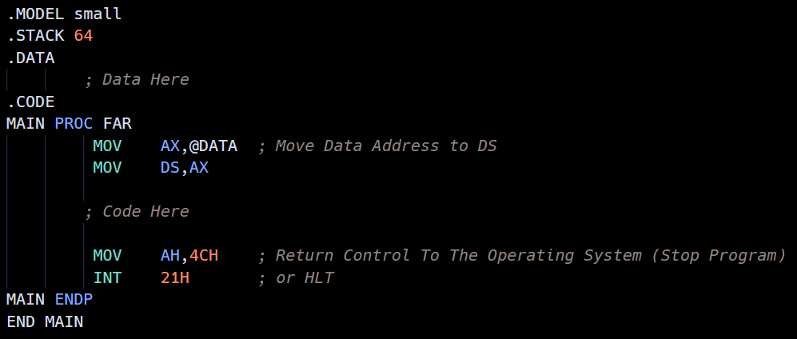
Program Structure
.Model directive tells the system if this program needs one segment or more in the memory
END MAIN tells the assembler that the code ended, and it starts from the label MAIN

Slide 3
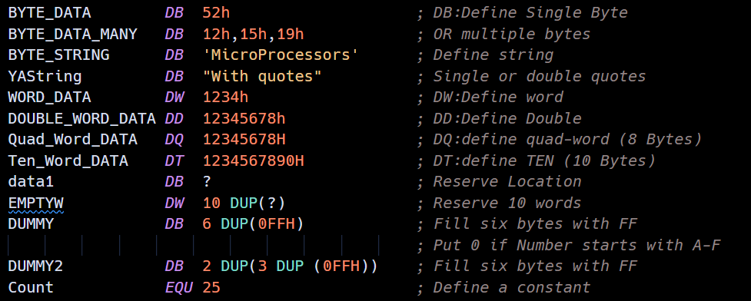
Variables
Only strings can be written without commas (,)
EQU is substituted in assembler

Slide 4
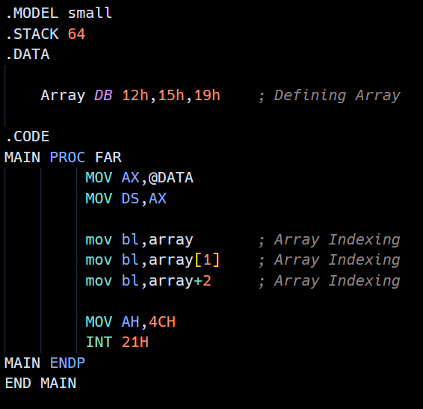
Arrays

Slide 5
Interrupts
We can Explore Interrupts in this Guide or This File

Slide 6
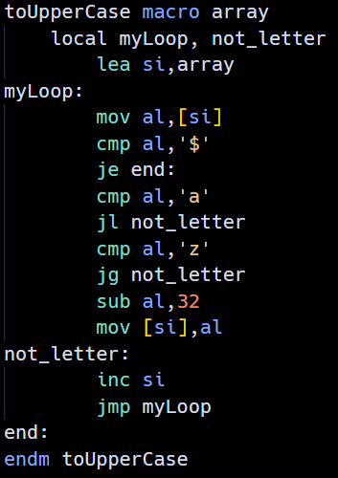
Macro
Macros are external code which will be substituted in the main code
Macros can take a variable name (which will be substituted on assembling)
Macros can’t have labels unless used with Local keyword
Macros (and procedures) can be written in external file and included using include [filename]

Slide 7
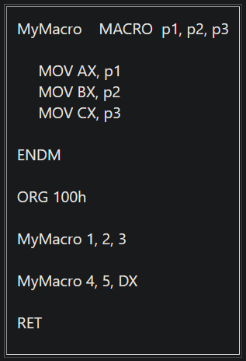
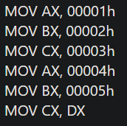
Macro

Slide 8
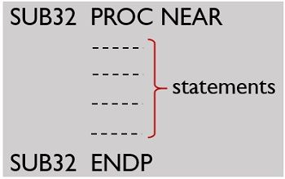
Procedures
Procedure use CALL and RET
Procedure change IP (Instruction pointer)
Procedures take no variables but use Stack to pass data

Slide 9
CALL & RET
CALL Pushes IP (holding next instruction address) to Stack then sets Procedure’s address in IP
RET reverses CALL action: Pops IP from Stack
NEAR and FAR:
If procedure is defined as NEAR:
Only IP is pushed and popped from Stack (in CALL & RET)
If procedure is defined as FAR:
CS is pushed and popped with IP from Stack (in CALL & RET)
In some assemblers, procedures are NEAR unless FAR word is used

Slide 10
Problem 1
Write a program that adds the following two multiword numbers and save the result using one-word transfer at a time:
DATA1 = 5463F8A8D37EH
DATA2 = 87DE340892C2H
Code

Slide 11
Problem 2
Repeat the previous program to subtract the two multiword numbers and saves the result. Subtraction should be done a byte at a time.
Same as Problem 1 but with SBB and byte by byte

Slide 12
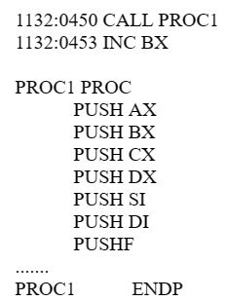
Problem 3
In some applications it is a common practice to save all registers at the beginning of a subroutine. Assume that SP = 1288H before a subroutine CALL. For the following code:
Show the contents of the stack pointer and the exact memory contents of the stack after PUSHF

Slide 13
Problem 3
Bottom of Memory
Stack
Stack cont.
SP = 1288H
Top of Memory

Slide 14
Problem 3
Bottom of Memory
Stack
Stack cont.
53
04
SP = 1286H
Top of Memory

Slide 15
Problem 3
Bottom of Memory
Stack
Stack cont.
AL
AH
53
04
SP = 1284H
Top of Memory

Slide 16
Problem 3
Bottom of Memory
Stack
Stack cont.
BL
BH
AL
AH
53
04
SP = 1282H
Top of Memory

Slide 17
Problem 3
Bottom of Memory
Stack
Stack cont.
CL
CH
BL
BH
AL
AH
53
04
SP = 1280H
Top of Memory

Slide 18
Problem 3
Bottom of Memory
Stack
Stack cont.
CL
CH
BL
BH
AL
AH
53
04
DL
DH
SP = 127EH
Top of Memory

Slide 19
Problem 3
Bottom of Memory
Stack
Stack cont.
CL
CH
BL
BH
AL
AH
53
04
SI (Lower)
SI (Higher)
DL
DH
SP = 127CH
Top of Memory

Slide 20
Problem 3
Bottom of Memory
Stack
Stack cont.
CL
CH
BL
BH
AL
AH
53
04
DI (Lower)
DI (Higher)
SI (Lower)
SI (Higher)
DL
DH
SP = 127AH
Top of Memory

Slide 21
Problem 3
Bottom of Memory
Stack
Stack cont.
SP = 1278H
CL
CH
BL
BH
AL
AH
53
04
FLAGS (Lower Byte)
FLAGS (Higher Byte)
DI (Lower)
DI (Higher)
SI (Lower)
SI (Higher)
DL
DH
Top of Memory

Slide 22
Problem 3
In some applications it is a common practice to save all registers at the beginning of a subroutine. Assume that SP = 1288H before a subroutine CALL. For the following code:
To restore the original information inside the CPU at the end of a CALL to a subroutine, the sequence of POP instructions must follow a certain order. Write the sequence of POP instructions that will restore the information. At each point, show the contents of the SP.
Reverse Order of Push Operations

Slide 23
Problem 4
The following program contains some errors. Fix the errors and make the program run correctly. This program adds four words and saves the result.
Hint: 9 Mistakes

Slide 24
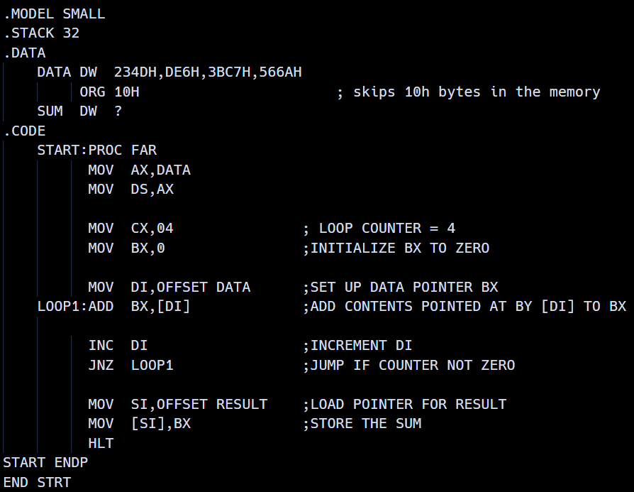

Slide 26
Hex Starts With 0
Invalid Name
Extra colon
Missing @
Invalid Name
We need to skip 2 byte (word): add 2
JNZ doesn’t decrement CX
No Variable Result
Invalid Name

Slide 27
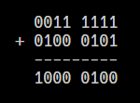
Problem 5
Find CF, ZF, and AF for each of the following. Also indicate the result of the addition and where the result is saved
MOV BH,3FH ADD BH,45H
CF | ZF | AF
0 | 0 | 1
The result will be stored in: BH

Slide 28
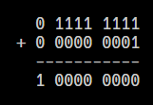
Problem 5
Find CF, ZF, and AF for each of the following. Also indicate the result of the addition and where the result is saved
MOV BX,0FF01H ADD BL,BH
CF | ZF | AF
1 | 1 | 1
The result will be stored in: BL

Slide 29
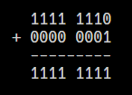
Problem 5
Find CF, ZF, and AF for each of the following. Also indicate the result of the addition and where the result is saved
MOV AH,0FEH STC ADC AH,00
CF | ZF | AF
0 | 0 | 0
The result will be stored in: AH

Slide 30

Problem 5
Find CF, ZF, and AF for each of the following. Also indicate the result of the addition and where the result is saved
MOV DX,4599H MOV CX,3458H ADD CX,DX
CF | ZF | AF
0 | 0 | 1
The result will be stored in: CX

Slide 31

Problem 5
Find CF, ZF, and AF for each of the following. Also indicate the result of the addition and where the result is saved
MOV AX,255 STC ADC AX,00
CF | ZF | AF
0 | 0 | 1
The result will be stored in: AX

Slide 32
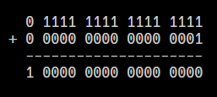
Problem 5
Find CF, ZF, and AF for each of the following. Also indicate the result of the addition and where the result is saved
MOV CX,0FFFFH STC ADC CX,00
CF | ZF | AF
1 | 1 | 1
The result will be stored in: CX

Slide 33

Problem 6
Assume that the following registers contain these HEX contents: AX = F000, BX = 3456, and DX = E390. Perform the following operations. Indicate the result and the register where it is stored. Give also ZF and CF in each case.
Note: the operations are independent of each other.
AND DX,AX
CF | ZF
0 | 0
The result will be stored in: DX

Slide 34
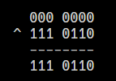
Problem 6
Assume that the following registers contain these HEX contents: AX = F000, BX = 3456, and DX = E390. Perform the following operations. Indicate the result and the register where it is stored. Give also ZF and CF in each case.
Note: the operations are independent of each other.
XOR AL,76H
CF | ZF
0 | 0
The result will be stored in: AL

Slide 35
Problem 6
Assume that the following registers contain these HEX contents: AX = F000, BX = 3456, and DX = E390. Perform the following operations. Indicate the result and the register where it is stored. Give also ZF and CF in each case.
Note: the operations are independent of each other.
XOR AX,AX
0
CF | ZF
0 | 1
The result will be stored in: AX

Slide 36
Problem 6
Assume that the following registers contain these HEX contents: AX = F000, BX = 3456, and DX = E390. Perform the following operations. Indicate the result and the register where it is stored. Give also ZF and CF in each case.
Note: the operations are independent of each other.
AND AH,0FF
F0
CF | ZF
0 | 0
The result will be stored in: AH

Slide 37
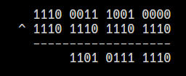
Problem 6
Assume that the following registers contain these HEX contents: AX = F000, BX = 3456, and DX = E390. Perform the following operations. Indicate the result and the register where it is stored. Give also ZF and CF in each case.
Note: the operations are independent of each other.
XOR DX,0EEEEH
CF | ZF
0 | 0
The result will be stored in: DX

Slide 38

Problem 6
Assume that the following registers contain these HEX contents: AX = F000, BX = 3456, and DX = E390. Perform the following operations. Indicate the result and the register where it is stored. Give also ZF and CF in each case.
Note: the operations are independent of each other.
MOV CL,04 SHL AL,CL
0
CF | ZF
0 | 1
The result will be stored in: AL

Slide 39
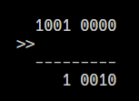
Problem 6
Assume that the following registers contain these HEX contents: AX = F000, BX = 3456, and DX = E390. Perform the following operations. Indicate the result and the register where it is stored. Give also ZF and CF in each case.
Note: the operations are independent of each other.
MOV CL,3 SHR DL,CL
CF | ZF
0 | 0
The result will be stored in: DL

Slide 40
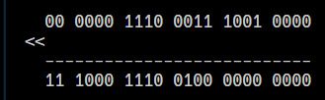
Problem 6
Assume that the following registers contain these HEX contents: AX = F000, BX = 3456, and DX = E390. Perform the following operations. Indicate the result and the register where it is stored. Give also ZF and CF in each case.
Note: the operations are independent of each other.
MOV CL,6 SHL DX,CL
CF | ZF
0 | 0
The result will be stored in: DX

Slide 41
Problem 7
Indicate the status of ZF and CF after CMP is executed in each of the following cases.
MOV BX,2500 CMP BX,1400
No need to calculate
No borrow
And not zero
CF | ZF
0 | 0

Slide 42
Problem 7
Indicate the status of ZF and CF after CMP is executed in each of the following cases.
SUB AX,AX CMP AX,0000
0
CF | ZF
0 | 1

Slide 43
Problem 7
Indicate the status of ZF and CF after CMP is executed in each of the following cases.
MOV DL,34 CMP DL,88
No need to calculate
Result needs borrow
And not zero
CF | ZF
1 | 0

Slide 44
Problem 7
Indicate the status of ZF and CF after CMP is executed in each of the following cases.
MOV AL,0FFH CMP AL,6FH
No need to calculate
No borrow
And not zero
CF | ZF
0 | 0

Slide 45
Problem 7
Indicate the status of ZF and CF after CMP is executed in each of the following cases.
XOR DX,DX CMP DX,0FFFFH
No need to calculate
Result needs borrow
And not zero
CF | ZF
1 | 0

Slide 46
Problem 7
Indicate the status of ZF and CF after CMP is executed in each of the following cases.
MOV BX,2378H MOV DX,4000H CMP DX,BX
No need to calculate
No borrow
And not zero
CF | ZF
0 | 0

Slide 47
Problem 7
Indicate the status of ZF and CF after CMP is executed in each of the following cases.
SUB CX,CX DEC CX CMP CX,0FFFFH
0h – 1h = 0FFFFh
0FFFFh - 0FFFFh = 0h
No borrow
but zero
CF | ZF
0 | 1

Slide 48
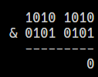
Problem 7
Indicate the status of ZF and CF after CMP is executed in each of the following cases.
MOV AL,0AAH AND AL,55H CMP AL,00
No borrow
but zero
CF | ZF
0 | 1

Slide 49
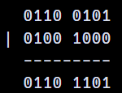
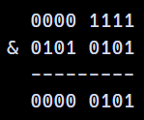
Problem 8
Indicate whether the jump happens in each case.
MOV CL,5 SUB AL,AL SHL AL,CL JNC TARGET
MOV BH,65H MOV AL,48H OR AL,BH SHL AL,1 JC TARGET
MOV AH,55H SUB DL,DL OR DL,AH MOV CL,AH AND CL,0FH SHR DL,CL JNC TARGET
Yes
No
No

Slide 50
Problem 9
Write a program to convert all uppercase letters to lowercase.
.Data
InputString DB 'THis iS A TEsT MESsaGE’
ResultString DB 22 DUP(?)
Code

Slide 51
Problem 10
An instructor named Mr. Mo Allem has the following grading policy: "Curving of grades is achieved by adding to every grade the difference between 99 and the highest grade in the class." If the following are the grades of the class, write a program to calculate the grades after they have been curved: 81, 65, 77, 82, 73, 55, 88, 78, 51, 91, 86, 76. Your program should work for any set of grades.
Code

